Slide 1



#DLBCN
Deep Architectures
A Review of neural network architectures and their compositions, with code snippets in PyTorch!
Santiago Pascual de la Puente
santi.pascual@upc.edu
Universitat Politècnica de Catalunya

Slide 2
Outline
What is in here?
Basic Architectures
Fully Connected Layers
Recurrent Layers
Convolutional Layers
Advanced Architectures
Hybrid CNN/RNN = QRNN
Auto-Encoders
Deep Classifiers/Deep Regressors
Residual Connections/Skip Connections, U-Net and SEGAN
GANs (DCGAN)
Conclusions

Slide 3

The “Full” Story
F. Van Veen, “The Neural Network Zoo” (2016)

Slide 4
The “Full” Story
F. Van Veen, “The Neural Network Zoo” (2016)

Slide 5
What is in here?

Slide 6
What is in here?
Let’s discuss about the options and nits of each topology.
Let’s unveil the applicability of different complex structures to different tasks.
Let’s try to map our theory to bits of code.
Google Colab URL to follow up code

Slide 7
Basic Architectures

Slide 8
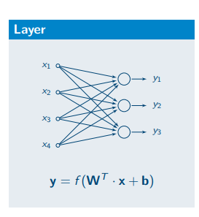
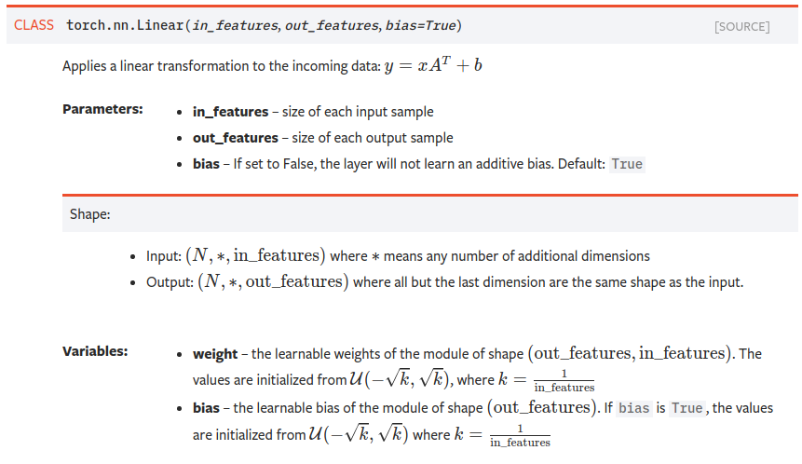
Fully Connected

Slide 9
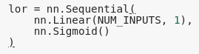
Fully Connected: A perceptron
Fully connected layer with one unit. A sigmoid activation makes it a logistic regression (binary linear classifier):
1
x1
b
w1
x2
σ
y = {0, 1}
w2
x3
w3

Slide 10
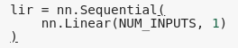
Fully Connected: A perceptron
Fully connected layer with one unit. No activation makes it a linear regression:
1
x1
b
w1
x2
y = {-inf, inf}
w2
x3
w3

Slide 11
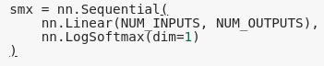
Fully Connected: Multiclass classifier
Fully connected layer with many units. Softmax activation makes it a “softmax classifier”.
y1
y2
y3
.
.
.
.
.
.
yN

Slide 12
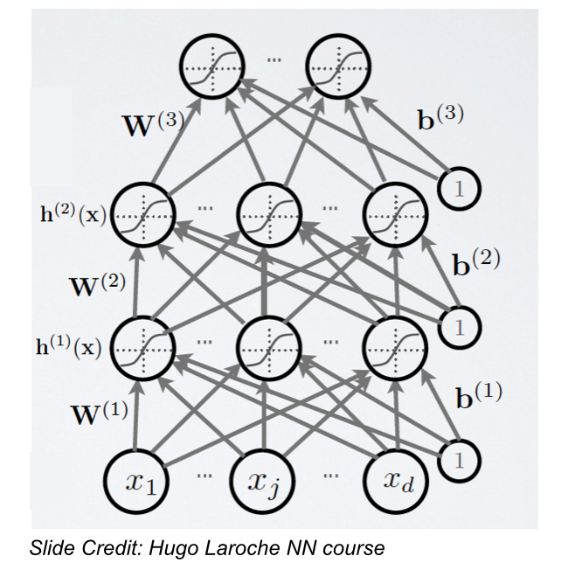
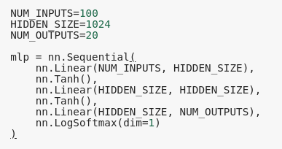
Fully Connected: MultiLayer Perceptron
This is also a deep neural network of course.
Many fully connected layers with many units.

Slide 13
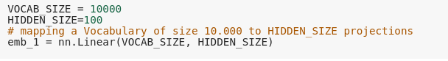
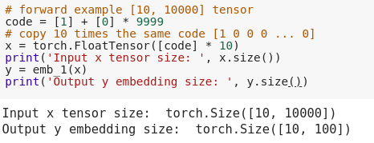
Fully Connected: When input is discrete...
We usually take one-hot codes as discrete tokens. Can we use a Linear layer to process it?
one-hot code
y1
0
1
y2
0
y3
.
.
.
.
.
.
0
yN

Slide 14
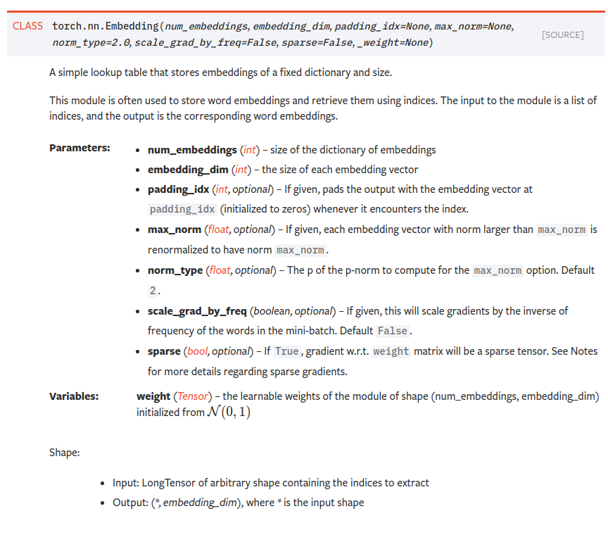
Embedding Layer
Each x as an Integer 0 or 1

Slide 15
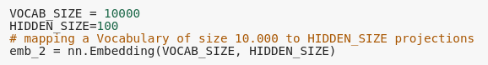
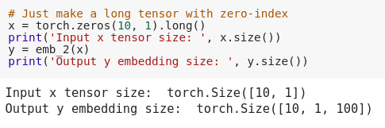
Fully Connected: Embedding Layer
Embedding layer makes an efficient lookup operation, not a full matrix multiplication (just select one-hot index column from weight matrix!)
one-hot code
y1
0
1
y2
0
y3
.
.
.
.
.
.
0
yN

Slide 16
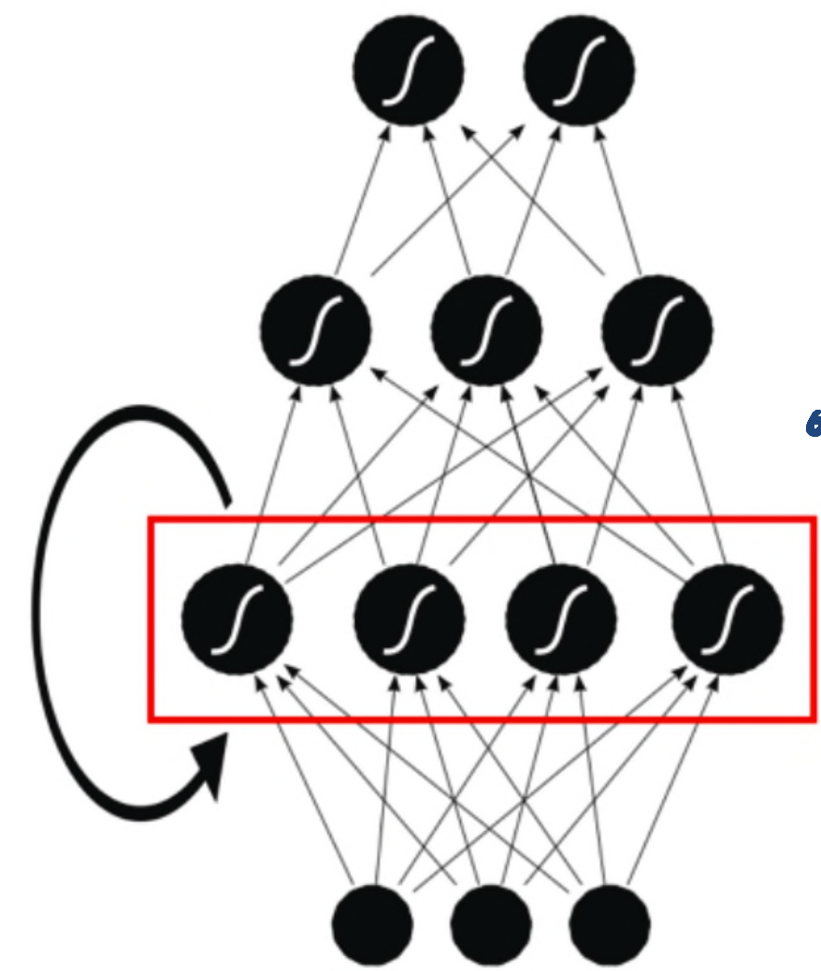
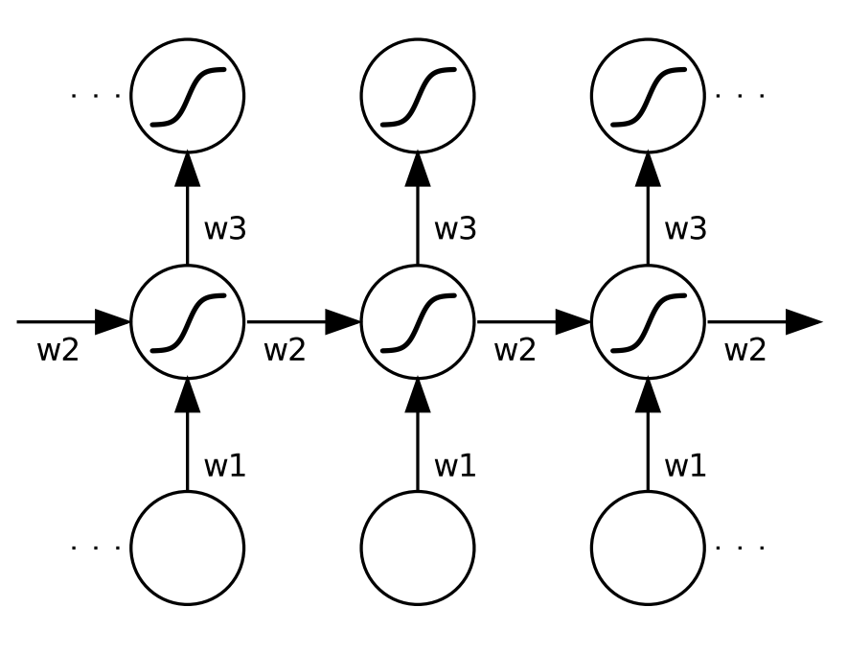
Recurrent Layer
Rotation 90º
time
time
Recurrent Layer

Slide 17
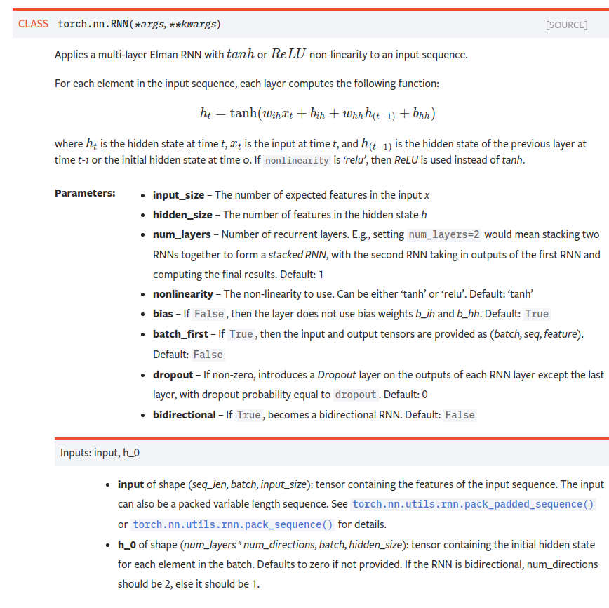
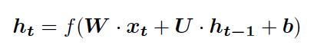
Recurrent Layer
time

Slide 18
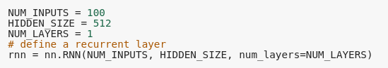
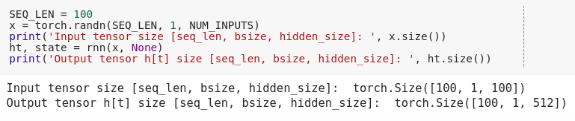
Recurrent Layer
time

Slide 19
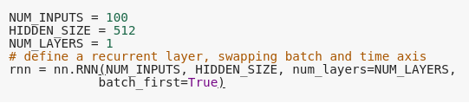
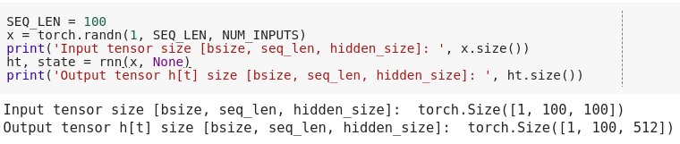
Recurrent Layer
BEWARE with axis definition in the 3D Tensor!
time

Slide 20
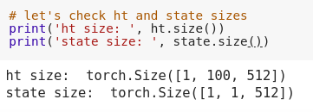
Recurrent Layer
Last time-step state
time

Slide 21
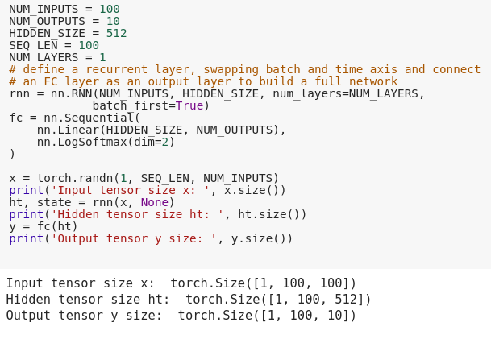
Recurrent Layer
Connecting an RNN with a FC layer
time
BEWARE: with batch_first=False this straightforward connection would NOT work

Slide 22
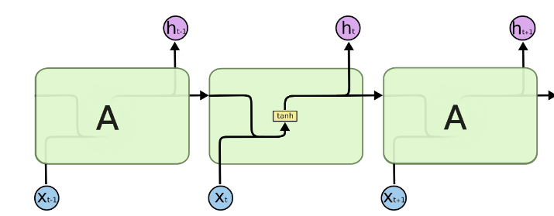
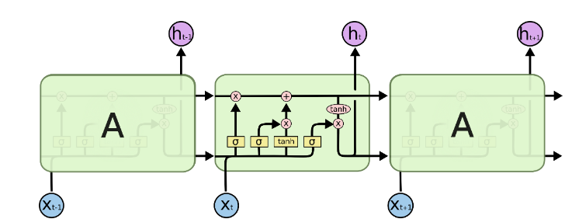
From RNN to LSTM
Gatings AND memory cell state

Slide 23
From RNN to LSTM
Gatings AND memory cell state
ct
ht

Slide 24
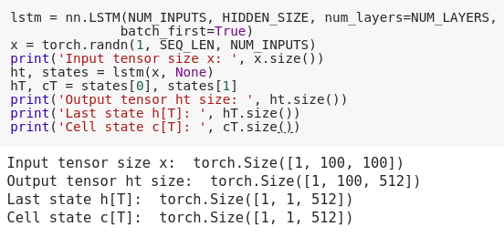
LSTM Layer
BEWARE: LSTM has two states! The internal cumulative one, and the bounded output one.
ct
ht
time

Slide 25
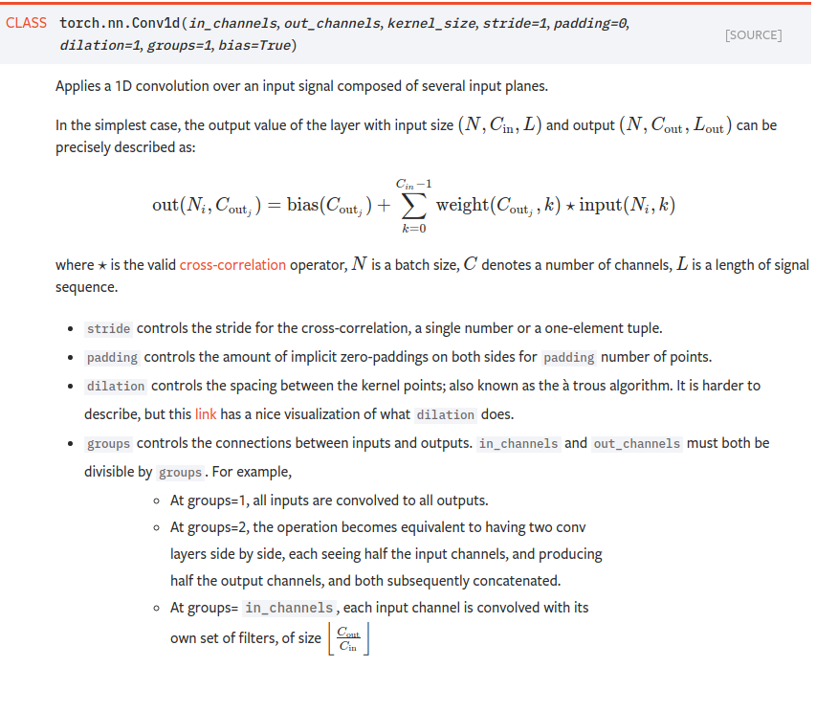
Convolutional Layer
x
1 2 3 4 5 6 7 8
w1 w2 w3
w1 w2 w3
w1 w2 w3
w1 w2 w3
w1 w2 w3
w1 w2 w3
y
1 2 3 4 5 6

Slide 26
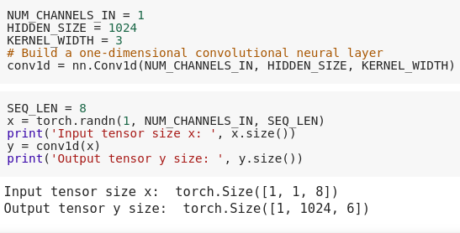
Convolutional Layer
x
1 2 3 4 5 6 7 8
w1 w2 w3
w1 w2 w3
w1 w2 w3
w1 w2 w3
w1 w2 w3
w1 w2 w3
y
1 2 3 4 5 6
We obtain 1024 y sequences

Slide 27
Convolutional Layer
x
1 2 3 4 5 6 7 8
w1 w2 w3
w1 w2 w3
Observe the axis shape of the convolutional layer: [bsize, channels, seq_len], different than RNN!
w1 w2 w3
w1 w2 w3
w1 w2 w3
w1 w2 w3
y
1 2 3 4 5 6
We obtain 1024 y sequences

Slide 28
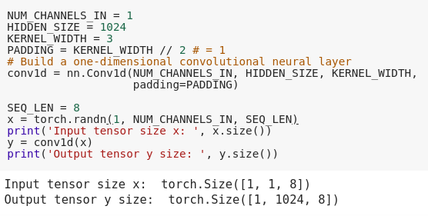
Convolutional Layer (padding)
x
0
1 2 3 4 5 6 7 8
0
w1 w2 w3
w1 w2 w3
w1 w2 w3
w1 w2 w3
w1 w2 w3
w1 w2 w3
w1 w2 w3
w1 w2 w3
y
We obtain 1024 y sequences
1 2 3 4 5 6 7 8

Slide 29
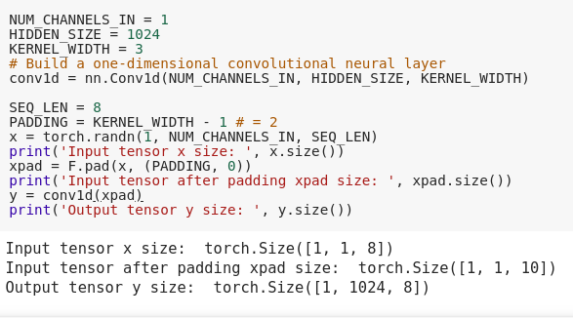
Causal Convolutional Layer
x
0
0
1 2 3 4 5 6 7 8
w1 w2 w3
w1 w2 w3
w1 w2 w3
w1 w2 w3
w1 w2 w3
w1 w2 w3
w1 w2 w3
w1 w2 w3
y
1 2 3 4 5 6 7 8
We obtain 1024 y sequences

Slide 30
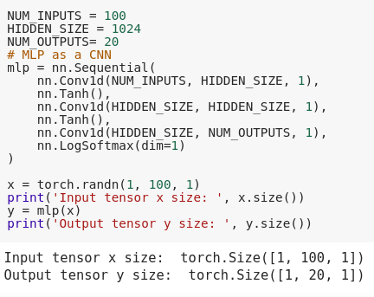
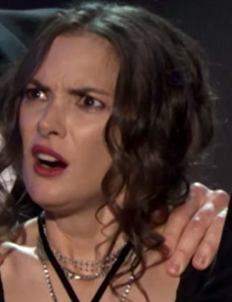
Multi-Layer Perceptron
An MLP? Whut??

Slide 31
Multi-Layer Perceptron
kernel of width 1 is equivalent to a fully connected layer sweeping in time!
Time axis MUST be included
An MLP? Whut??

Slide 32
Multi-Layer Perceptron
kernel of width 1 is equivalent to a fully connected layer sweeping in time!
Key message here: arranging your data is as important as defining the model structure. For example with a 3-D tensor of proper shape we can use a convolutional network as a multi-layer perceptron!
Time axis MUST be included
An MLP? Whut??

Slide 33
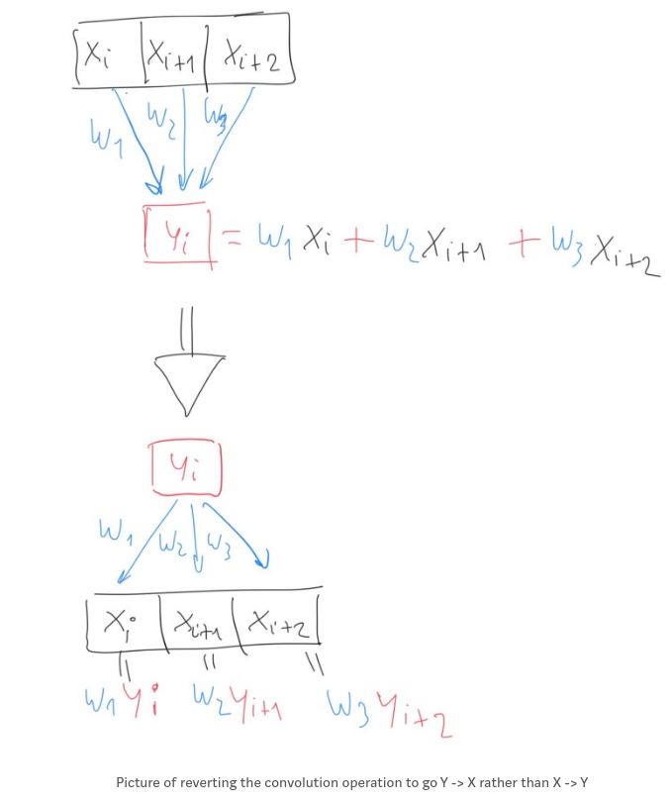
Transposed Convolutional Layer
Revert the convolution operation, sending weighted pieces of input to make many outputs.
Medium post on “How PyTorch Transposed Convs1D Work”

Slide 34
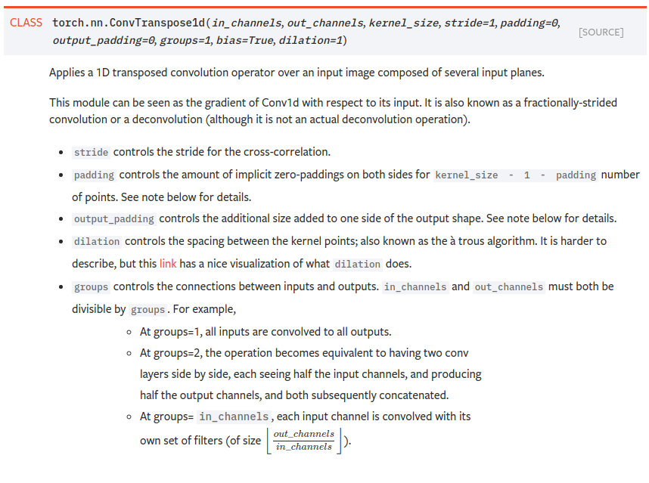
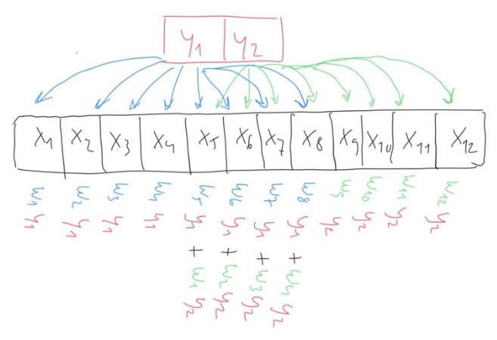
Transposed Convolutional Layer
It works as a learnable upsampler!
Example with x6 upscaling factor

Slide 35
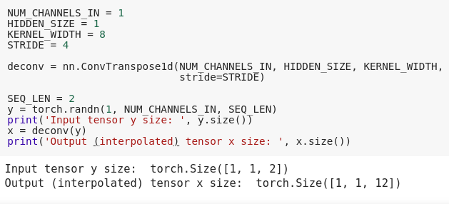
Transposed Convolutional Layer

Slide 36
Advanced Architectures

Slide 37
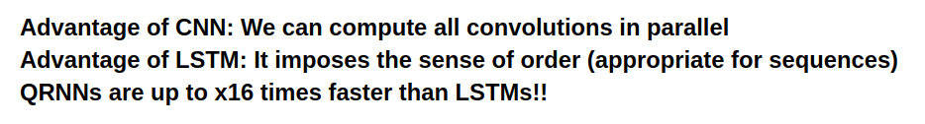
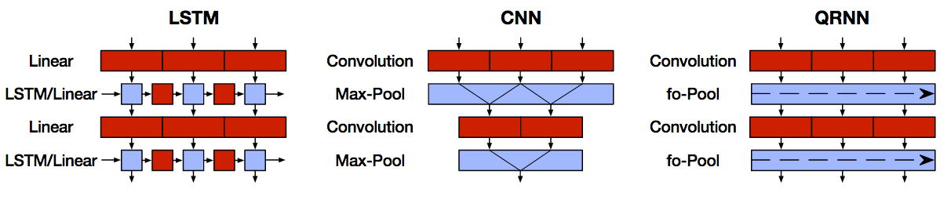
Quasi Recurrent Neural Network (QRNN)
Quasi-Recurrent Neural Networks (Bradbury et al. 2016)
Mix the best of both worlds!

Slide 38
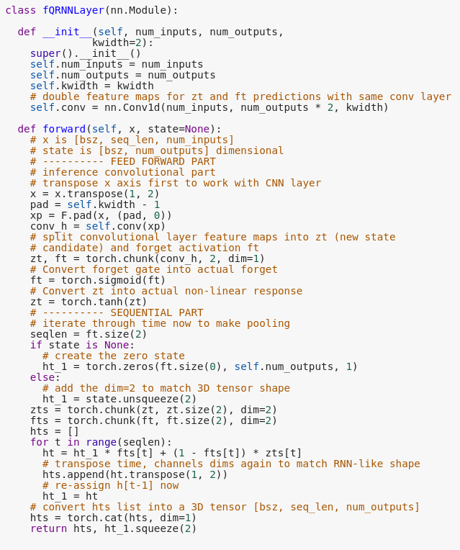
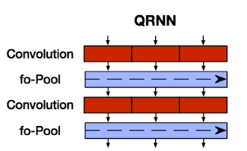
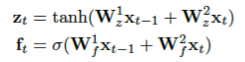
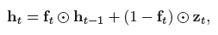
Quasi Recurrent Neural Network (QRNN)
(1) Use a causal CNN to first forward all inputs sequentially; (2) and then accumulate long-term memory to impose ordered processing with simple pooling.

Slide 39
Quasi Recurrent Neural Network (QRNN)
(1) Use a causal CNN to first forward all inputs sequentially; (2) and then accumulate long-term memory to impose ordered processing with simple pooling.
Good for advanced sequential processing: comparative performance to that of LSTMs at x16 less computational cost (with good CUDA implementation, not with this example code). Used in production for some state of the art text/speech synthesis systems.
Check the official & efficient implementation here.

Slide 40
Auto-Encoder Neural Network
Bottleneck
x
x^
Autoencoders:
Predict at the output the same input data.
Do not need labels
c
Encode
Decode

Slide 41
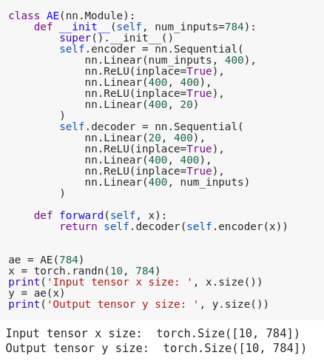
Auto-Encoder Neural Network
x^
Decode
c
Bottleneck
Encode
x

Slide 42

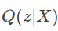
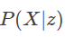
Variational Auto-Encoder
z
Encode
Decode

Slide 43
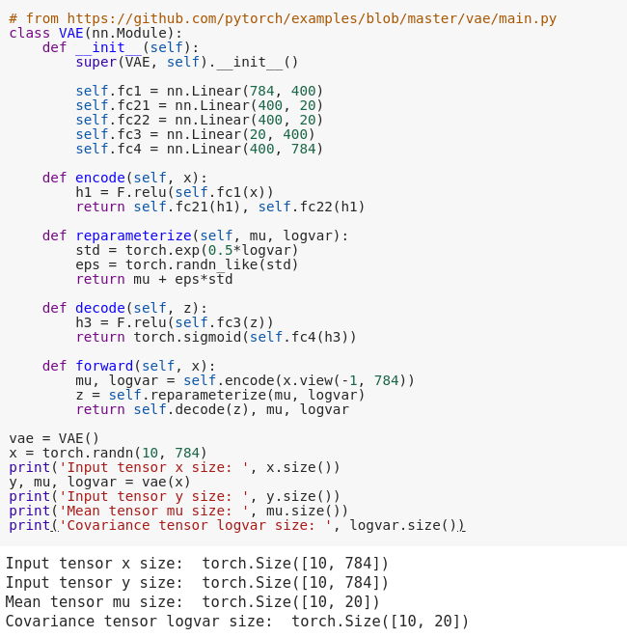
Variational Auto-Encoder
Decode
reparam. trick
z
Encode

Slide 44
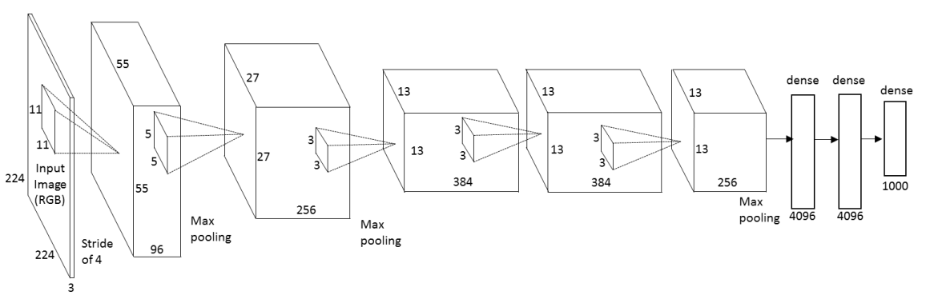
Deep Classifiers/Regressors
Front-end specific to signal type:
Images: Conv2D
Video: Conv2D + RNN or Conv3D
Text: Conv1D or RNN or both
Speech: Conv1d or Conv2d or RNN or combinations
MLP decisor with classification or regression output.
Pooling: MaxPool, AvgPool, Strided Convolutions...

Slide 45
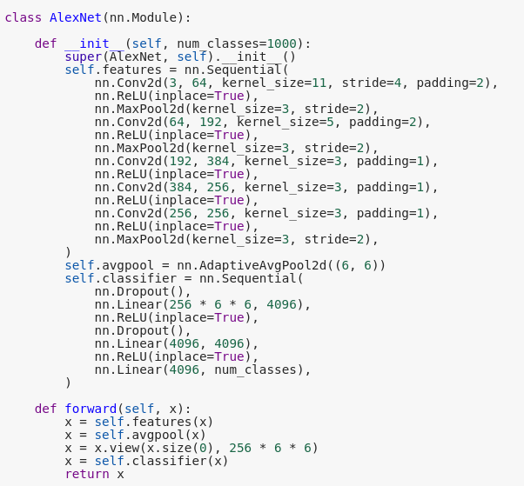
Deep Classifiers/Regressors

Slide 46
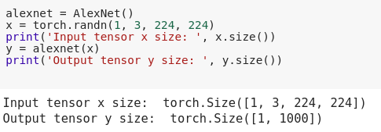
Deep Classifiers/Regressors

Slide 47
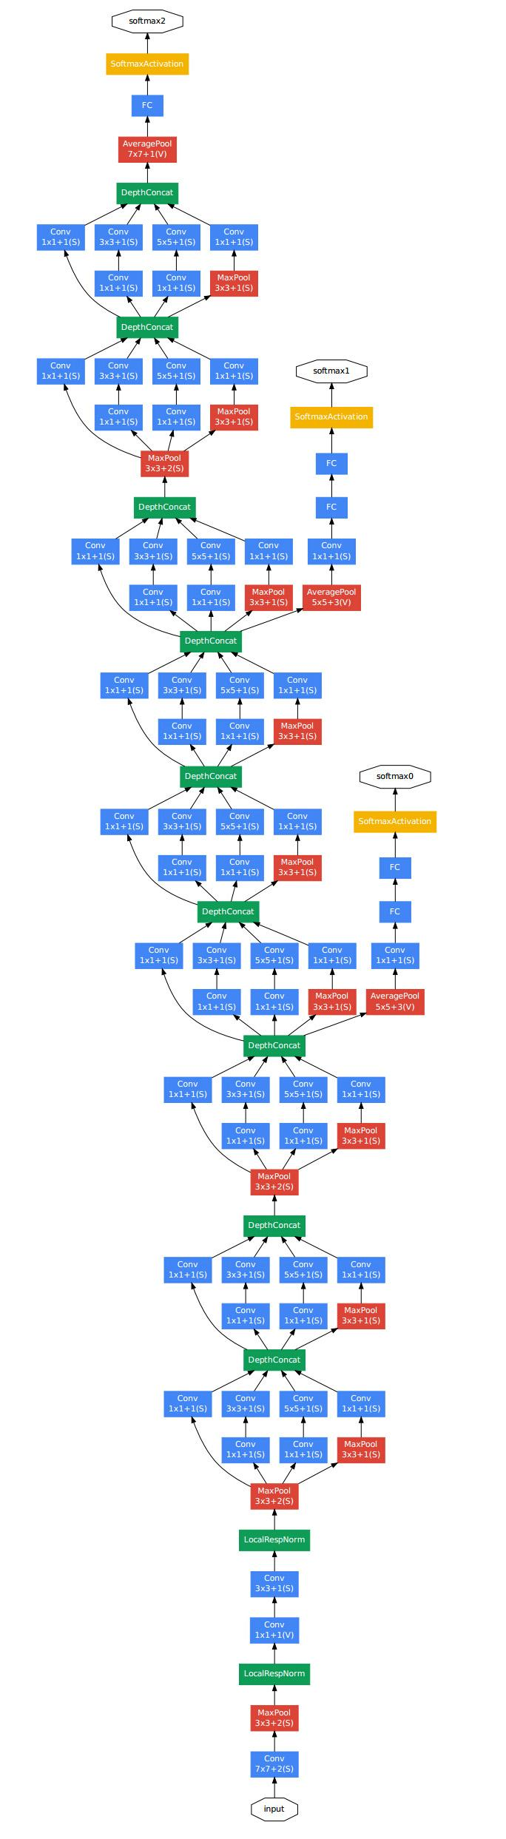
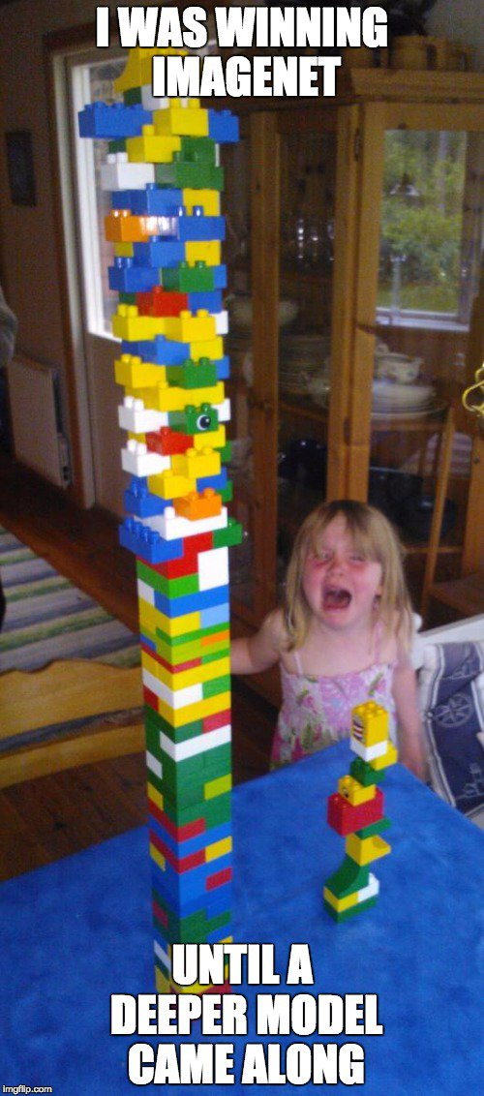
Inception module
Slide credit: Xavi Giro

Slide 48


Inception module / Network in Network
GoogleNet
Slide credit: Xavi Giro
Szegedy, Christian, Wei Liu, Yangqing Jia, Pierre Sermanet, Scott Reed, Dragomir Anguelov, Dumitru Erhan, Vincent Vanhoucke, and Andrew Rabinovich. "Going deeper with convolutions." CVPR 2015

Slide 49

Inception module / Network in Network
Lin, Min, Qiang Chen, and Shuicheng Yan. "Network in network." ICLR 2014.
Slide credit: Xavi Giro

Slide 50
Deep Residual Networks

Slide 51

Deep Residual Networks
Slide credit: Xavi Giro
He, Kaiming, Xiangyu Zhang, Shaoqing Ren, and Jian Sun. "Deep residual learning for image recognition." CVPR 2016 [slides]

Slide 52

Deep Residual Networks
Residual learning: reformulate the layers as learning residual functions with reference to the layer inputs, instead of learning unreferenced functions
He, Kaiming, Xiangyu Zhang, Shaoqing Ren, and Jian Sun. "Deep residual learning for image recognition." CVPR 2016 [slides]

Slide 53

Deep Residual Networks
Residual learning: reformulate the layers as learning residual functions with reference to the layer inputs, instead of learning unreferenced functions

Slide 54
Deep Residual Networks
Slide credit: Xavi Giro
Non-Residual connections
Residual connections
He, Kaiming, Xiangyu Zhang, Shaoqing Ren, and Jian Sun. "Deep residual learning for image recognition." CVPR 2016 [slides]

Slide 55



Deep Residual Networks
Slide credit: Xavi Giro
3.6% top 5 error…
with 152 layers !!

Slide 56

Deep Residual Networks
Humans
He, Kaiming, Xiangyu Zhang, Shaoqing Ren, and Jian Sun. "Deep residual learning for image recognition." CVPR 2016 [slides]

Slide 57

Skip connections
Slide credit: Xavi Giro
Figure: Kilian Weinberger

Slide 58

Skip connections
Slide credit: Xavi Giro
Long, Jonathan, Evan Shelhamer, and Trevor Darrell. "Fully convolutional networks for semantic segmentation." CVPR 2015 & PAMI 2016.

Slide 59

Skip connections: U-Net
Downsampling Encoder
(Downconv)
Upsampling Decoder
(Deconv)
Ronneberger, Olaf, Philipp Fischer, and Thomas Brox. "U-net: Convolutional networks for biomedical image segmentation." In International Conference on Medical Image Computing and Computer-Assisted Intervention, pp. 234-241. Springer International Publishing, 2015

Slide 60


Skip connections: SEGAN
SEGAN in PyTorch GitHub

Slide 61

Skip connections: SEGAN
SEGAN in PyTorch GitHub

Slide 62

Skip connections: SEGAN
SEGAN in PyTorch GitHub

Slide 63






Generative + Adversarial
D is a binary classifier, whose objectives are: database images are Real, whereas generated ones are Fake .
Real world samples
Database
Sample
Real
Discriminator
Loss
Generator
Fake
Sample
Latent random variable
z
G must be realistic to keep competing against D.

Slide 64

Adversarial Training (batch update) (1)
Pick a sample x from training set
Show x to D and update weights to output 1 (real)

Slide 65

Adversarial Training (batch update) (2)
G maps sample z to ẍ
show ẍ and update weights to output 0 (fake)

Slide 66

Adversarial Training (batch update) (3)
Freeze D weights
Update G weights to make D output 1 (just G weights!)
Unfreeze D Weights and repeat

Slide 67

Generating images/frames
Deep Conv. GAN (DCGAN) effectively generated 64x64 RGB images in a single shot. It is also the base of all image generation GAN architectures.
fully connected
fully connected
Strided transposed conv layers
Conv layers,
no max-pool
(Radford et al. 2015)

Slide 68

DCGAN
PyTorch official example

Slide 69

DCGAN
PyTorch official example

Slide 70
Conclusions

Slide 71
Conclusions
We have reviewed basic architectures (most fundamental layers), their relations against each other, and their implementations.
We made some implementations that change some basic block properties/efficiency (i.e. Embedding, causal convolution, etc.).
We have reviewed some advanced architectures built on top of the basic ones.
Hybrid combinations of basic blocks with QRNN
Auto-Encoder structures to do unsupervised learning and generative modeling
Deep convolutional classifiers, their evolutions in ImageNet challenge and residual connections.
Skip connections and their usage in deep architectures and U-Net structures.
DCGAN has been revisited, breaking down its generator and discriminator structure.
All these shown models serve as templates for many typical applications (at least as starting point)
Combining the mentioned structures often boosts results, but often with a data hungry trade-off as complexity grows.

Slide 72


Thanks! Questions?

